Slide 1
Project 1 - Standardized Test Analysis
Janet, Matthew, Clement

Slide 2

Standardized tests raise tons of questions

Slide 3
Standardized tests are controversial:
Are they the right selection tool to get into college?
If yes, which one should be taken? SAT or ACT?
Based on articles and datasets, we have chosen to focus on SAT 2017-2018-2019 data per state
Problem statement:
"Does looking at SAT scores averages per state paint a correct picture of academic performance for a given state?"
Notes:
*https://www.washingtonpost.com/education/2019/03/19/is-it-finally-time-get-rid-sat-act-college-admissions-tests/*
*https://www.theatlantic.com/ideas/archive/2022/04/mit-admissions-reinstates-sat-act-tests/629455/*
*https://www.testgeek.com/blog/a-look-at-the-average-sat-score-by-state/*
https://prepmaven.com/blog/test-prep/states-require-sat-act/

Slide 4
Part 2 -
Data import and Cleaning
First part of an EDA is to do some data cleaning
Ensuring df integrity:
existing dimensions,
missing or wrong values
replacing, deleting (cleaning) what needs to be
renaming columns
Useful methods used :
pd.read_csv ( to create dataframes)
.loc (to filter df)
.replace (to replace a certain character in a given field)
.apply(to apply a function to a dimension)
.rename(columns ={x,y})
.concat (to “stack” homogenous df together)
.drop(columns=[‘xyz]) to remove columns from df
Notes:
- Imagine this is important just as how chefs prepare the ingredients before cooking!
- basically we ensure dataframe integrity by checking existing dimension & missing values, remove duplicate, drop null value, set data to right type & format, add variable/ masking, rename columns.
- List of methods we have used as shown.

Slide 5
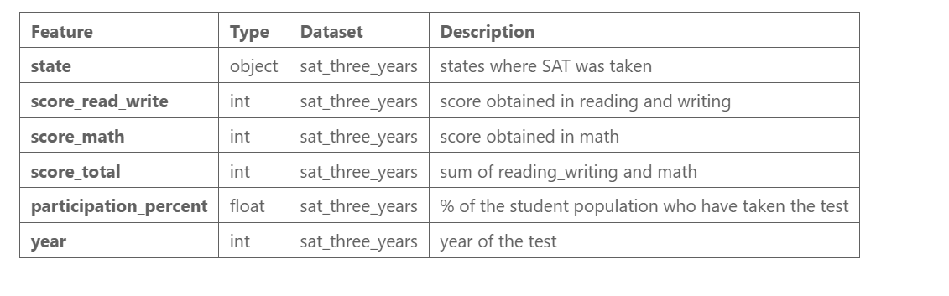
Import and cleaning output: 1 containing 3 years of data
Notes:
The 3 datasets that we have used for our projects are SAT 2017, 2018 and 2019.

Slide 6
Exploratory Data Analysis
Large part of addressing a problem statement is the Exploratory Data Analysis (EDA)
In this phase, we discover the major characteristics contents in our data with help of descriptive summary statistics and graphical representation.
Useful methods used:
.groupby (to summarize mean, sum and variance in a pivot-table fashion)
.corr ( to see correlation matrix in a table form )
.sort_values
Notes:
After data cleaning, here we set to perform EDA, which is a large part in addressing a problem statement. We perform initial investigations on data to discover patterns, spot anomalies and to check assumptions with the help of descriptive summary statistics and graphical representation. List of methods we have used.

Slide 7
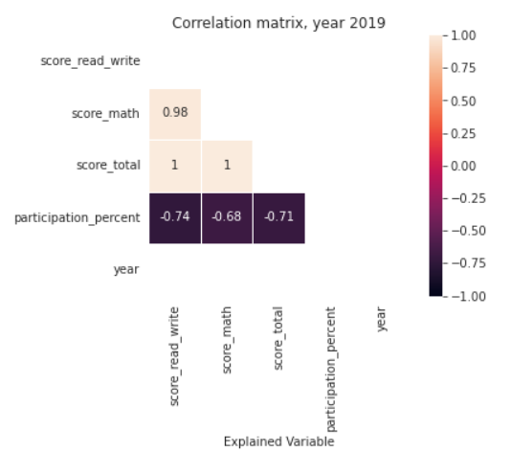
Visualization
Correlation matrix showing a strong negative correlation (>|0.5|) between participation percentage and score_total
Notes:
Look at heatmap correlation to understand the strength of the relationship between SAT participation to SAT score by state.
Positive correlation occurs when two variables move in the same direction; as one increases, so do the other. For example, higher the score of each subjects, higher the total score.
Negative correlation occurs when two variables move in opposite directions. For example, higher the participation rate, lower SAT total score.
However, correlation does not necessarily imply causation; other factors may be at play.

Slide 8
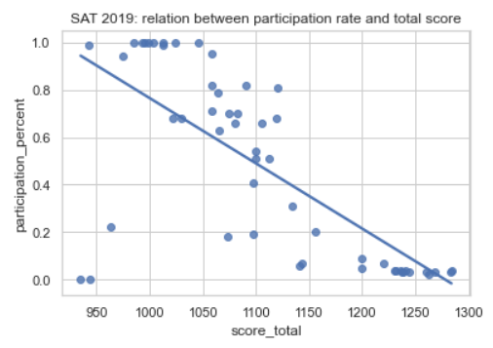
Visualization
Year 2019 scatterplot showing SAT total score vs participation rate
Notes:
To visualise the correlation more easily, we represent it in simple Linear Regression model.
Is “participation (independent variable)” statistically significant to “test score (dependent variable)”?
The closer the score is to the line, less scattering the data is.

Slide 9
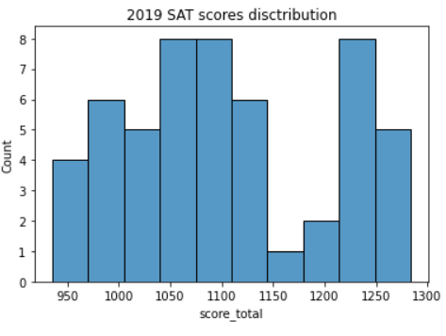
Visualization
SAT 2019 scores distribution shows 2 groups of states
( not “normally distributed”)
Notes:
36 of 53 states are on the left side of 1150 (67.92%)
6 highest score states was Minnesota, Wisconsin, South and North Dakota, Nebraska and Iowa.
Those 6 states are also the highest 6 in 2018.
As same as the graph one slide before, all these 6 states’ participation rate is lower than 4%, which they have more freedom to take a test.
Since it is not mandatory, only self-motivated students or students who need it for admission took the test, so it could affects the mean of each state.
It is based on states, so it is not showing the actual average of total participants in all the us states.

Slide 10
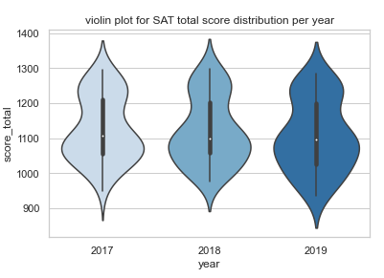
Visualization
Year 2019 has a larger spectrum of scores due to the addition of 2 states to the dataset
Notes:
Compare with 2017, 2018 and 2019 is significantly different.
2018 could be slightly easier that 2017, since we can see the lowest score is bit higher than 2017.
2019 could be slightly harder that 2017, since we can see the lowest score is big lower than 2017.
But still, since 1000 to 1100 is the biggest pie of all the years, it means test is designated to target the score range.

Slide 11
Conclusion
Problem statement:
"Does looking at SAT scores averages per state paint a correct picture of academic performance for a given state?"
SAT Score results seem heavily correlated to the % of participation in each state. this is verified for the last 3 years.
From several articles, this is explained by some states enforcing SAT before graduating from high school, and some don't.
This warrant a hypothesis testing to validate the significance of the relationship we observe.
We cannot answer the problem statement without further hypothesis testing.
Notes:
SAT mandatory states: Illinois, Ohio, Michigan, which is top 10 population states in US. This could affect the total score range.

